Slide 1


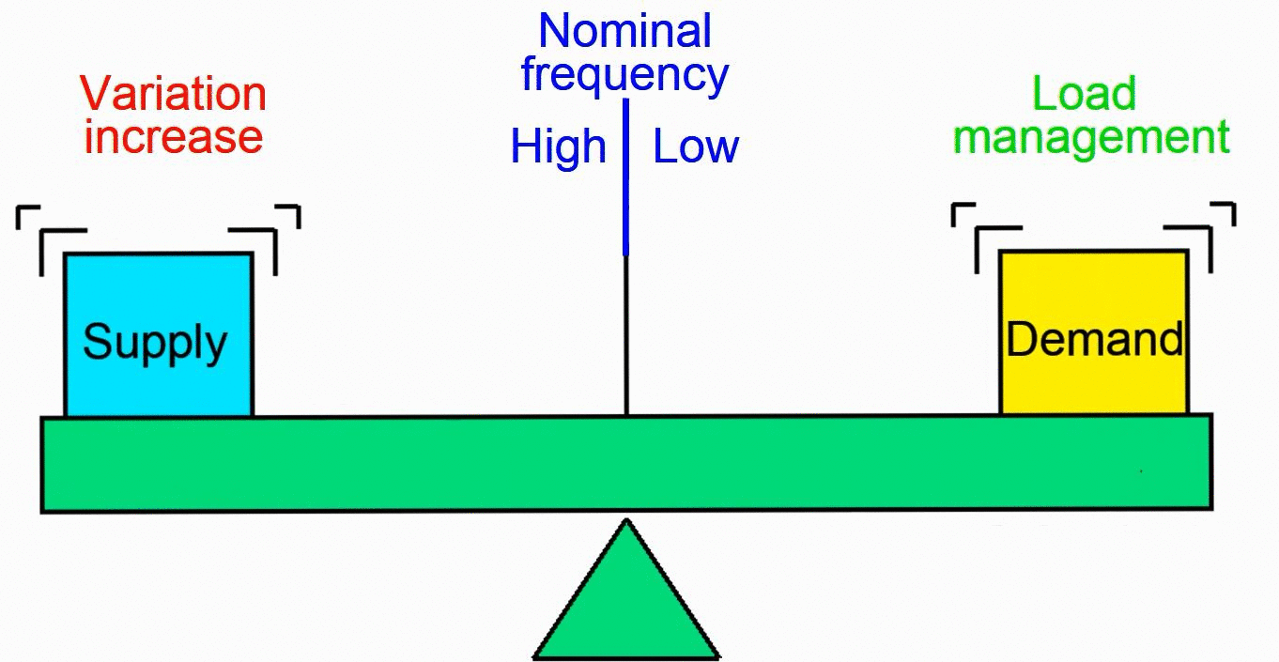
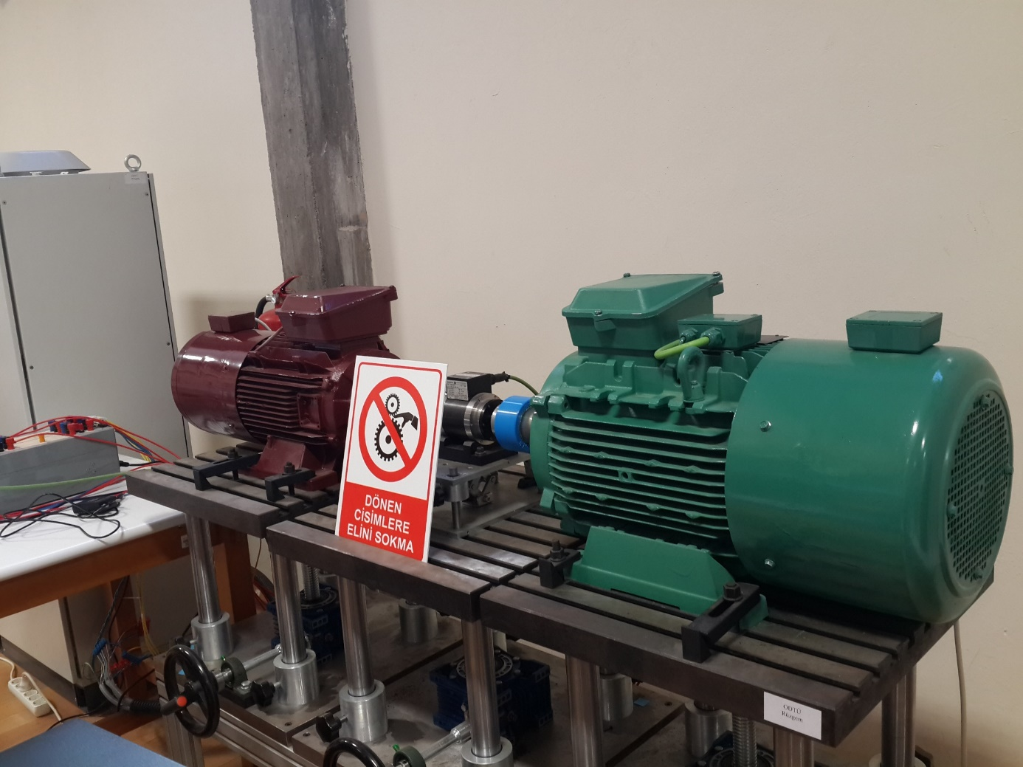
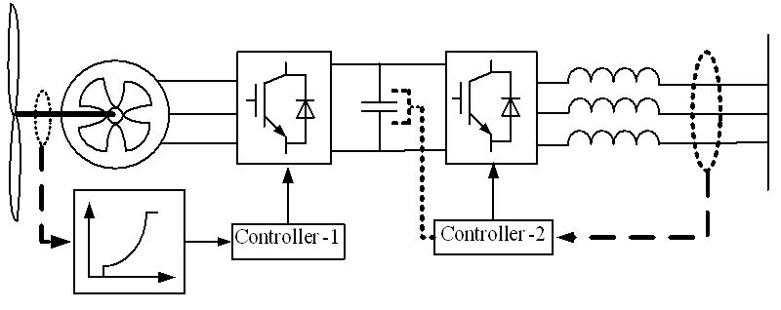
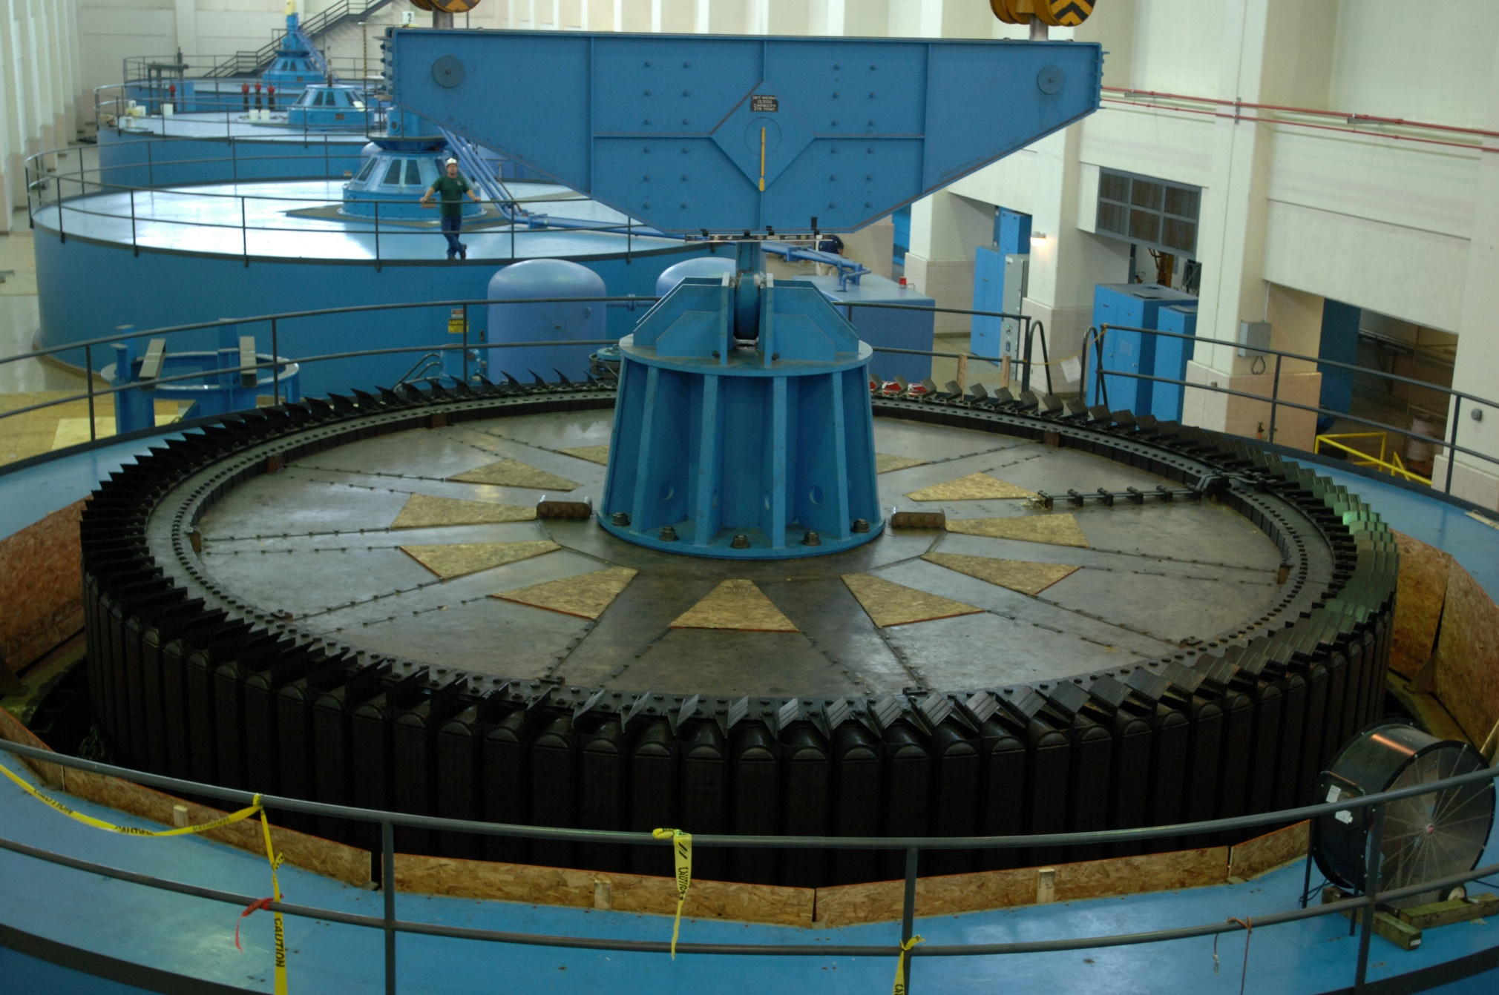
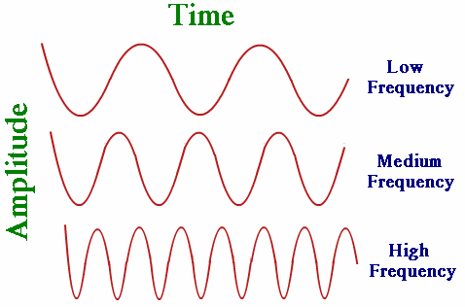
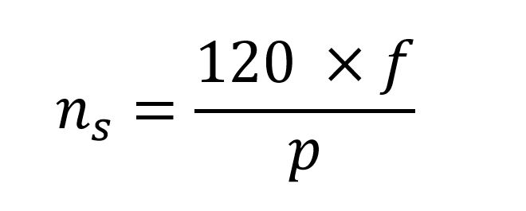
Enabling Wind Turbines for Actively Contribute to Grid Frequency Support with Synthetic Inertia Implementation
Erencan Duymaz, MSc in Electrical and Electronics Engineering, METU
Ozan Keysan, Ass. Prof. in Electrical and Electronics Engineering, METU
Abstract
Today vs Past
Wind Turbine Emulator
In this research study, a future challenge related to Renewable Power Generation has been investigated. As we integrate high amount of Renewable Sources to the Electricity Grid, the inertia of the electricity grid will continue to decrease. Unless the required measures are taken, the grid frequency will face with the problem of instability in the near future. This is why it is necessary for renewable sources to actively participate in frequency support in the electricity grid.
Some solutions are proposed in the literature as ‘Synthetic Inertia’ or ‘Virtual Inertia’ for the wind turbines for their active participation in a frequency deviation instant. Main motivation of this research study is implementing synthetic inertia in the wind turbine emulator and enabling wind turbines to contribute to grid frequency support.
In the old days, almost all of the generators in the power system network were synchronous generators. These generators have the natural ability to increase their power generation in the power deficit instant. As stated before, the generated power and consumed power have to be equal in order to maintain constant frequency in the network. If generation and consumption is not equal to each other, then difference between generation and consumption will be either supplied from or stored in the kinetic energy of the generators’ inertia.
What is changed today is the increasing amount of renewable power integration to grid. Aside from its benefits to earth such as reduced carbon dioxide emission or reduced global warming, it also brings some challenges to the system operators. One of the most important challenge related to renewable power generation is the problem of frequency instability due to the fact that they decrease the grid inertia. Even though there is a rotating body in the case of wind turbines, the inertia of the turbine is not reflected to grid side. In other words, the wind turbines are insensitive to the frequency deviations and they do not increase their power generation if the frequency falls down from its nominal value.
Wind Turbine Emulators are used to emulate the behavior of the Wind Turbines in the laboratory conditions. They are utilized for testing different control methods designed for wind turbines. In this study, a WTE located in the Mechanical Energy Conversion Laboratory will be used for implementing the Synthetic Inertia concept. WTE will be connected to synchronous generators and loads and in this way a testing environment will be constructed. After that, two test case will be tested. First, a load will be connected to this system suddenly. Second, one of the synchronous generators will be disconnected instantly.
Introduction
Frequency of the grid basically depends on the power balance between generation and consumption. If this balance is disturbed with ‘load connection’ or ‘generation outage’, then frequency of the grid starts to decrease. In order to understand this, some basic concepts have to be reviewed.
Frequency vs Inertia
Discussion
In the power area, frequency is simply related to rotational speed of the generators. For a 4 pole synchronous generator, if the rotational speed is 3000 rpm, then the frequency will be 50 Hz. If the rotational speed decreases below 3000 rpm, then the grid frequency goes below 50 Hz.
Inertia is natural tendency of an object to maintain its state of motion. It can also be thought as ‘rotational mass’. Inertia concept is quite important in terms of frequency stability due to the fact that synchronous generators in the power system network have huge inertia values which enables them store huge amount of kinetic energy in their inertia. This kinetic energy stored in the generator inertia is quite helpful in order to maintain frequency stability in the power system network.
At the end of this research study, it is expected that modified system structure will have more stable structure than the unmodified case. The tested cases will create a frequency drop obviously. However, the main motivation of this study is reducing this frequency drop with synthetic inertia implementation. There are also challenges to this research study.
Stalling risk of the wind turbine
Basic and accurate emulation of the grid in the laboratory conditions
Real-time data acquisition
Accurate frequency measurement and optimized generation increase
Synthetic Inertia
In the literature, solution to this problem is introduced as Synthetic Inertia or Virtual Inertia. Even though there exists no rotating body in the renewable source as in the case of Photovoltaic systems or isolated inertia in the case of Wind Turbines coupled to grid via power electronics, these renewable sources can be modified in a way that they imitate the behavior of the synchronous generators.
In the wind turbines, this can be achieved by utilizing the kinetic energy stored in the turbine blades. If the frequency of the grid falls below nominal value, then turbine speed reference is reduced. In order to reduce the turbine speed, generator torque should be increased. Note that it is impossible to decrease the turbine speed instantly since blades have a inertia meanwhile the it is possible to increase the generator torque in the milliseconds order. Then, the wind turbine supplies more power to the grid just like a synchronous generator for a defined time period.
Conclusions
Renewable sources bring many problems with their advantages. One of the most important problem in the near future will be the frequency stability. This study focuses on the one of the promising solution namely Synthetic Inertia and its implementation in the Wind Turbine Emulator (WTE).
Contact
References
Erencan Duymaz
PowerLab Research Group
Email: erencan.duymaz@metu.edu.tr
Website: blog.metu.edu.tr/e181402
Phone: 0538 225 15 85

